Slide 1
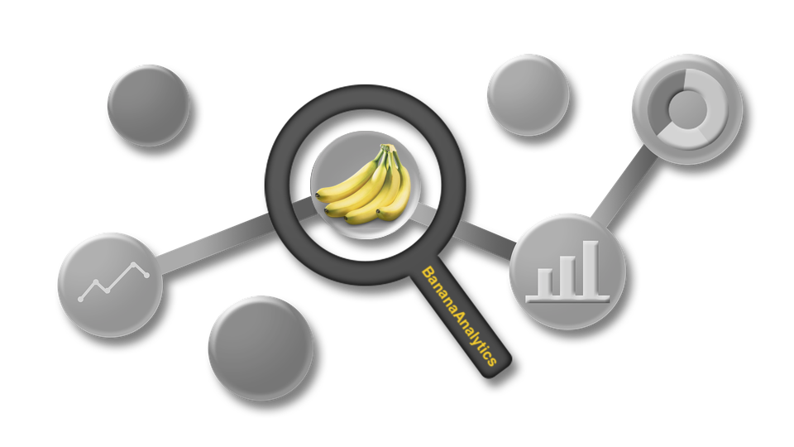
BananaAnalytics
presented by anton, david, felix and rahel

Slide 2




Project team
RAHEL WEHRLI
WIKI-CREATOR
DAVID FÜRER
PROJECT COORDINATOR AND PROCESS OWNER
ANTON LORVI
PROGRAMMER
FELIX SCHENKER
INVESTIGATOR & BUSINESS ANALYST
Notes:
Rahel to shortly introduce the project team and what each is going to present:
David -> coordinator and process owner is going to explain the current state
Anton -> programmer is going to introduce our solution
Felix -> Investigator and Buisness Analyst is going to describe our business

Slide 4






Problem (david)
Notes:
The bananatree are the data from the end-client. The auditor just needs specific information, represented by single bananas. And in the end, they are used for different analytics…

Slide 5
Customer Journey As-is
Finalize CoA, DM and IP: Description: After the receipt of the CoA from the data management team, DM and IP, the audit-team has to forward the data to the data management team. If the receipt data is not completed, the audit-team has coordinate the complement of the data with data management team.
GAP: Depends of the complement of the finalized data, the coordination effort can be very hight, to get the necessary needed data for the complement
Fill out request
Description: The audit-team fill out the excel with the <necessary needed data for the audit and send this to data management team
Bad
Neutral
Coordinate extraction
Description: After clarification of the evaluate, schedule, change, coordinate and adapting of the task, the auditor get an reminder from the data management team. In this step, the coordination competencies for the extraction/ providing data should be defined. The audit-team get an answer from the data management team about the clear competencies. Depends which data are needed, the audit-team or the data management team have to coordinate directly with the clients about the necessary extraction/ providing of the data
Receive data: Description: After extraction/ providing data on the site of the client, the audit-team has to forward the extracted and provided data to the data management team for the validation of the data.
GAP: This step is not valuable and needs a lot of time to forward the data in the correct form and structure to the data management team as well as to coordinate in the case for a correction with the client. It can be a very long cycle because of different adjustments
Satisfy
Horrible

Slide 6
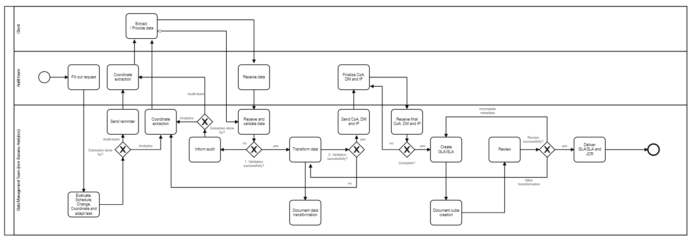
As-is

Slide 7
Solution (Anton)

Slide 8
Customer Journey with our solution
Fill out request
Description: The Audit-team fill out in a cloud based solution (owner is banana analytics) the necessary needed data for the audit and send this to Banana Analytics
Meta data completion and data upload
Description: After receipt the inquiry for data upload via email, the meta data completion, the audit-team upload the data in cloud based solution of Banana Analytics
Satisfy
Neutral
Data extraction and data upload
Description: After receipt the inquiry for data upload via email, the audit-team upload the data in cloud based solution of Banana Analytics. The reason for need of a human intervention is a variety in the extracted data requires a converter library in this step.
Very Gratifying

Slide 9

Business idea
The digitization of business processes, also in the audit business area, brings with it many new challenges and opportunities. The current audit approach and audit processing, e.g. through the use of standard structures, document checks and invoice-specific requirements, are very work-intensive and almost inefficient. In order to achieve the necessary complex regulations both from the point of view of the audit team and for the company to be audited, new support technologies are necessary for an efficient audit process.
To meet the necessary regular requirements, Banana Analytics offers the right solution for this requirement with new technology for the audit process. Banana Analytics has bundled the data preparation requirements and implemented a tool to prepare the data more efficiently for the audits.
Banana Analytics' simple and useful solution controls all the steps through the data analysis process. As a result, most of the manual steps can be automated. The solution allows the use of a mobile analysis solution or the installation directly on the client, without data loss.
Notes:
Felix to show the business opportunities of banana analytics

Slide 10
Who is involved in the autit process?
To get a better understanding about the different stakeholders, which will be involved in our business idea, we would like to describe this stakeholder firstly.
Audit team
Auditors perform (internal) financial and risk management audits and independent statutory (external) financial audits of commercial and public sector organizations. Auditors assess local and central government departments with the aim of improving efficiency and effectiveness.
Client (company to be audited)
The process audit is part of a company's QM system and should lead to capable and controlled processes that are robust against disturbance variables. The subject of the audit is the product development process/series production or a service development process/service provision.
Banana Analytics (Service provider with the analytics tool)
Banana Analytics offers the right solution for this requirement with new technology for the audit process. Banana Analytics has bundled the data preparation requirements and implemented a tool to prepare the data more efficiently for the audits.

Slide 11
Live demo

Slide 12


